Slide 1
Institutional Review Board Business Case
Echo Solutions
Kyle Grondin, Brandon Pichen, Anthony Barrios

Slide 2
Current Situation
Everything is paper based
Paper applications are turned into PDFs and emailed through the members
Comments are also in emails
There is no archiving, just saved in email
HIGHLY dependent on email and paper applications

Slide 3
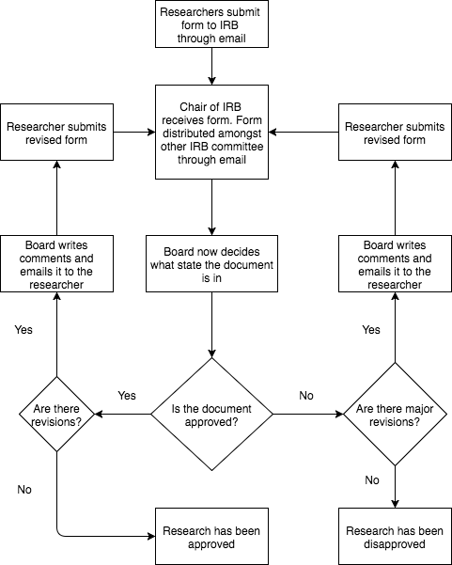
Current Situation Activity Diagram

Slide 4
Proposed Solution & Critical Success Factors
Develop an IRB web based application specified to your needs
Users can submit an application
Board members can view, comment, and chair can declare a state
Each application is archived, no matter the state
There is an exempt, and expedited application process alongside the normal process

Slide 5
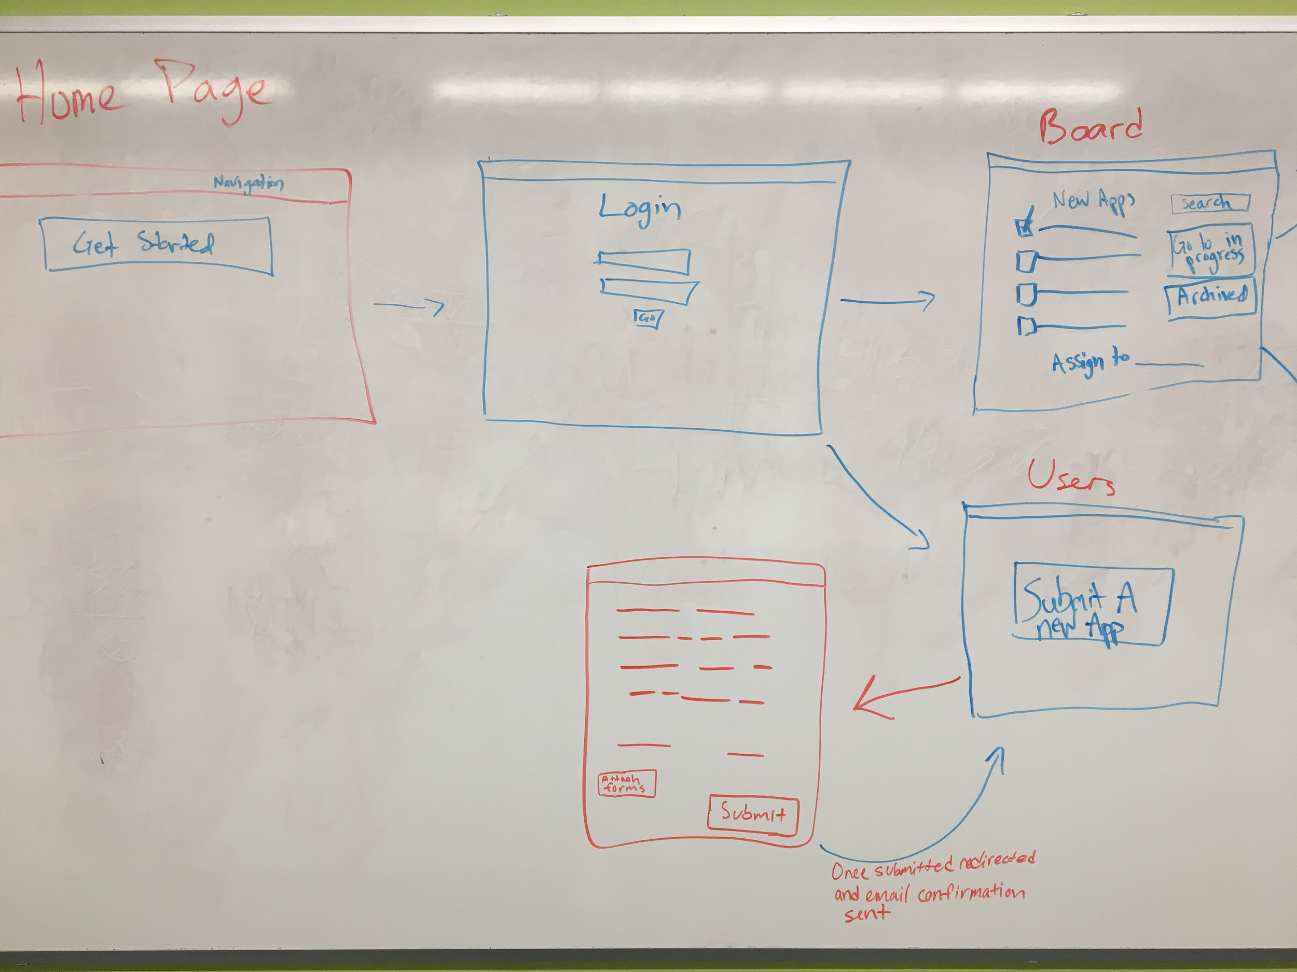

Slide 6
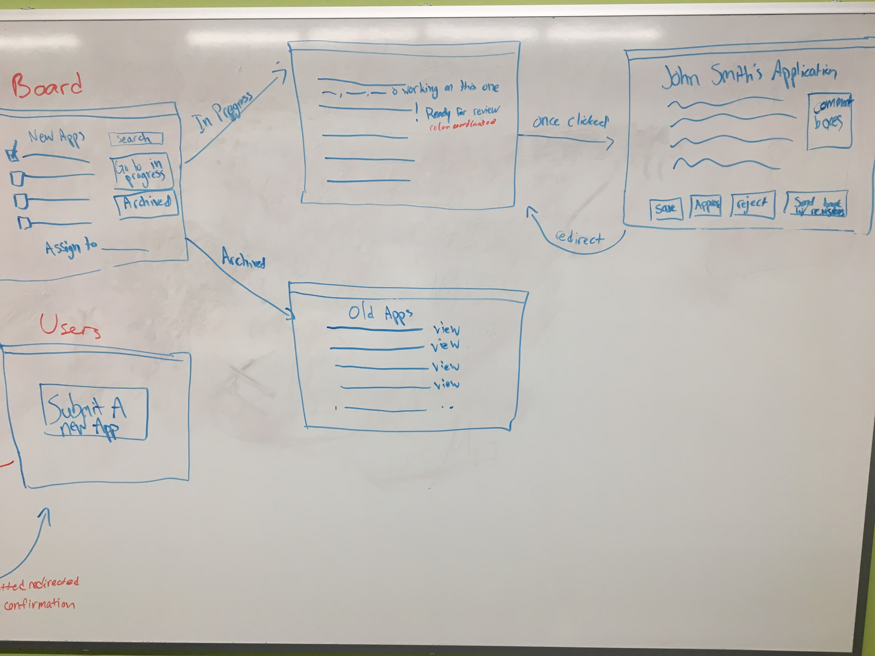

Slide 7
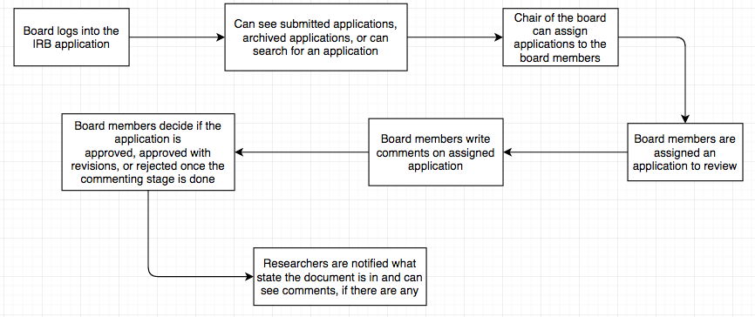
Boards View

Slide 8
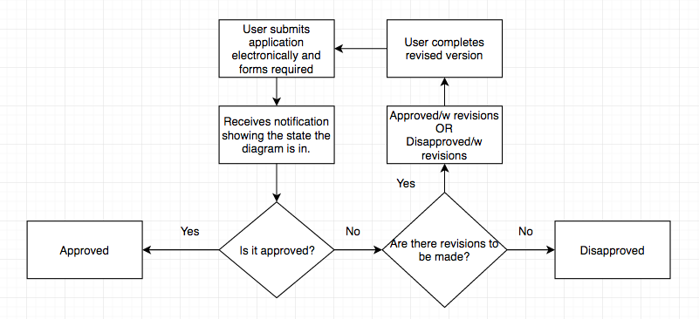
Users View

Slide 9
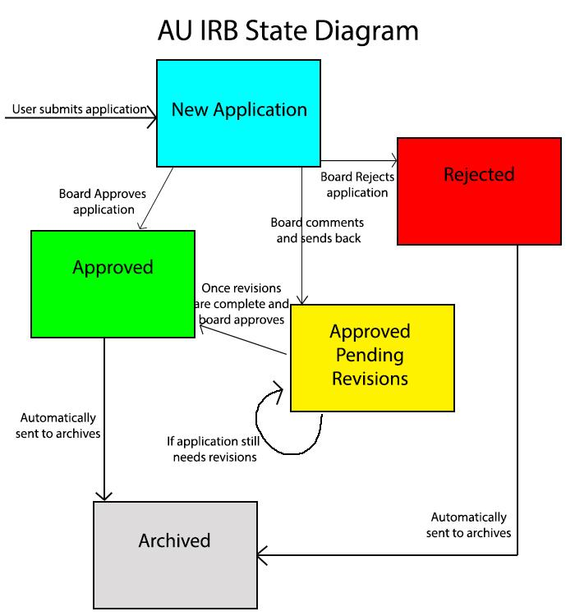

Slide 10
Alternative Solutions
IRBANA by DDOTS
OnBase by Hyland

Slide 11
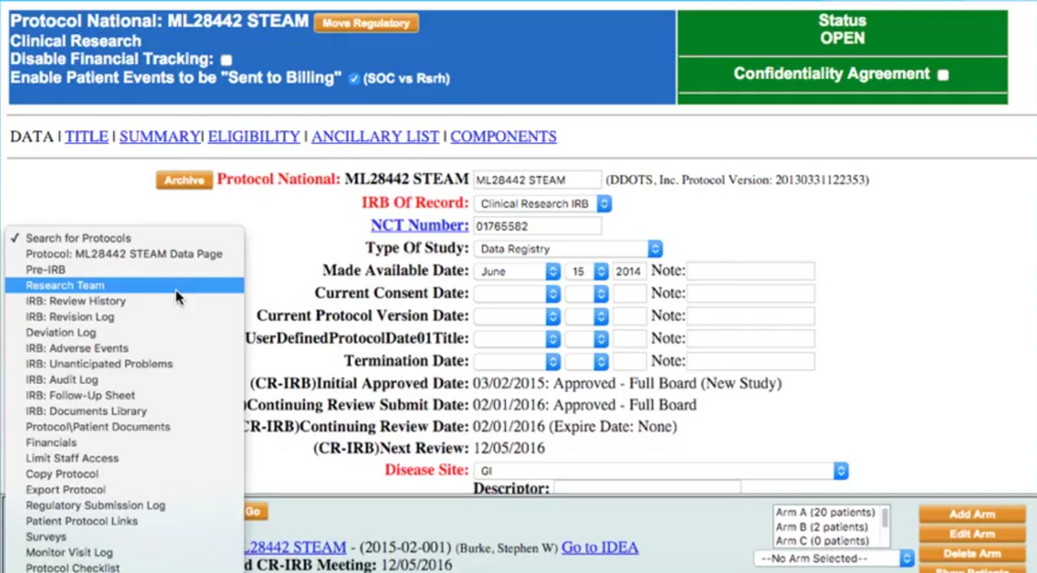
IRBANA by DDOTS

Slide 12
IRBANA
PROS
Focused on IRB functions
Has most of the things you need
CONS
Hasn’t been updated since 2013
Is aimed towards IRBs dealing with healthcare and medical trials
Lots of ‘bloat’ that isn’t necessary for our purposes
No expedited or exempt process

Slide 13
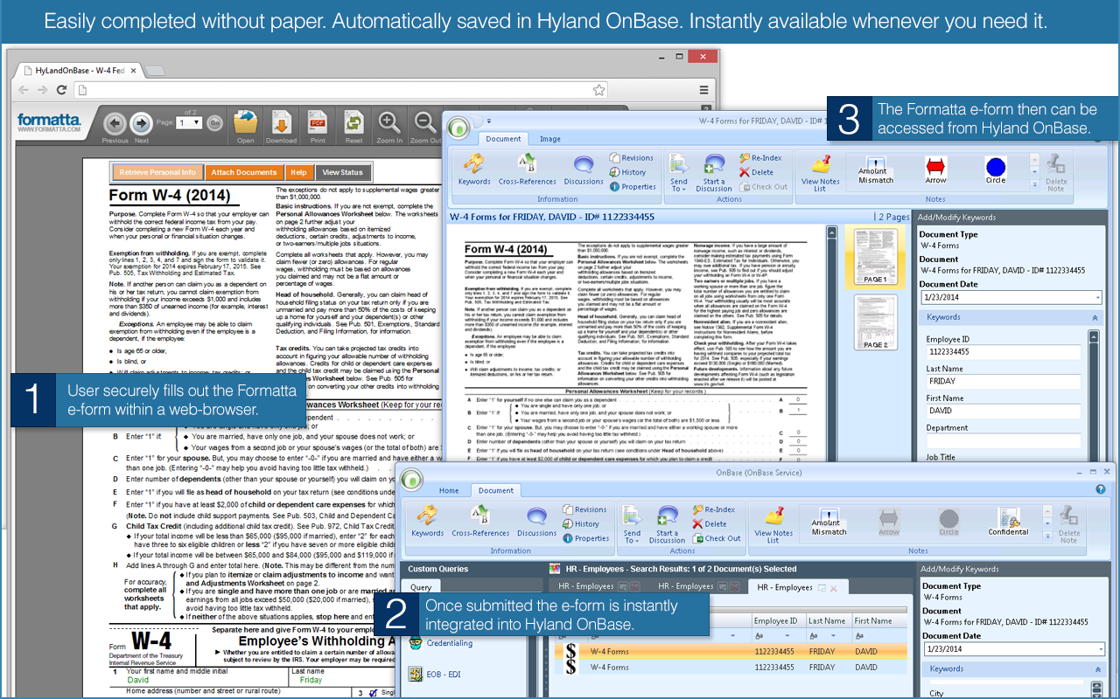
OnBase by Hyland

Slide 14
OnBase
PROS
Deals with more than just document management
Aurora University already looking into this
(Hopefully!) Does something similar to what you want
CONS
Super broad
Probably does some of what you want, but not everything you want
Would require waiting until it’s implemented, which could be longer than our implementation
No expedited or exempt process

Slide 15
What are other schools using?
A lot schools are not yet using an IRB application system
NIU, Loyola, Illinois University not yet on automated systems
Benedictine has specified IRB application
Specialized IRB software seems to be a newer concept
Get ahead of the game
Have Aurora University specific IRB

Slide 16
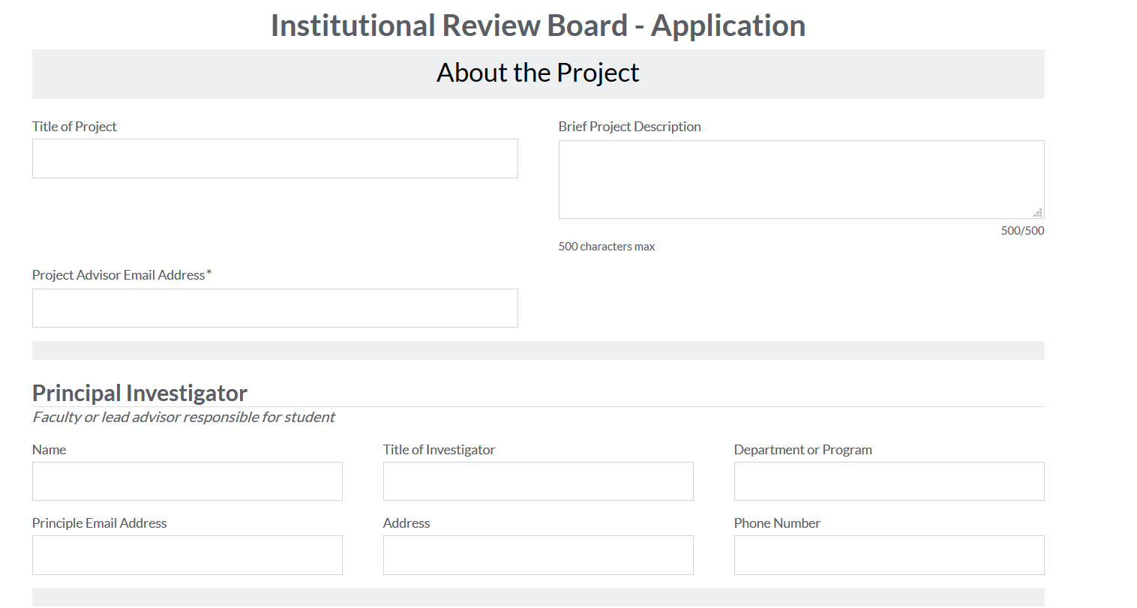
Taken from Benedictine’s Application process

Slide 17
What Impacts Will Our Solution Have
Paperless Review System
Time Efficiency
Reduces the amount of labor
Reduces the amount of time
Allows Easier Access for the review board
Simpler communication amongst the boards

Slide 18
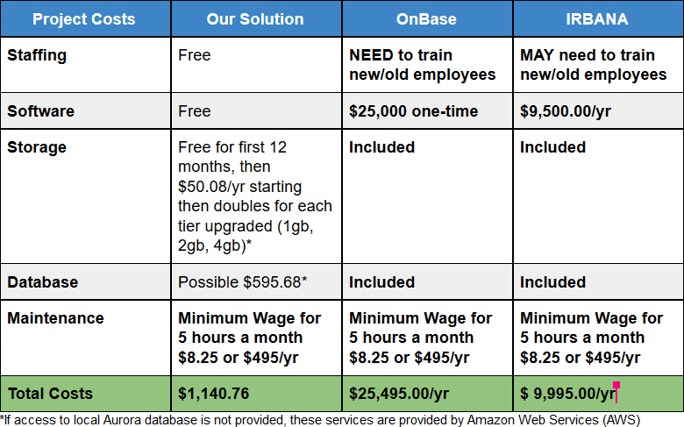
Costs

Slide 19
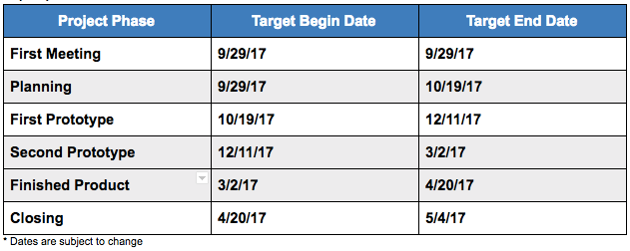
Deliverables and Timeline

Slide 20
What Happens If Project Is Postponed
IRB is left with an outdated system until OnBase is (hopefully) implemented
Paper based documents
Sharing documents through email
Comments will be in email, instead of document
More labor being put into the review board than necessary
Continues being time consuming

Slide 21
Conclusion
Echo Solutions believes creating a document review application that will meet the AU IRB requirements is the best course of action
Our first prototype is aimed at December
We believe our IRB Web Application will provide the best user experience for the AU Review Board

